Slide 1
Chapter 5
Access Control List

Slide 2

Understand the basic function of ACL
Know when and how to use ACL
Grasp the configuration of ACL
Specifically you should have to know
ACL conception and usage
ACL working principle
ACL types
ACL using rule, ACL grammar
ACL watching command

Slide 3
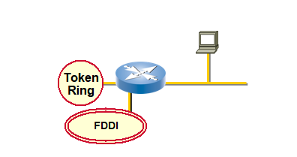
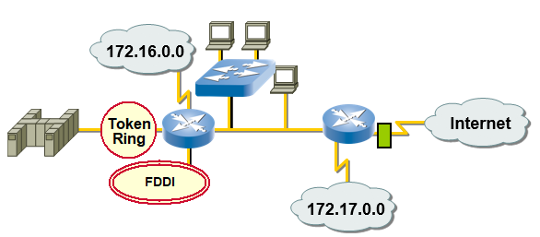
Why Use Access Lists?
a
b
Mange IP traffic as network access grows
Filter packets as they pass through the router

Slide 4
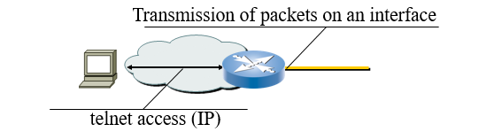
Access List Applications
Permit or deny packets moving through the router
Permit or deny telnet access to or from the router
Without access lists all packets could be transmitted onto all parts of your network
K

Slide 5
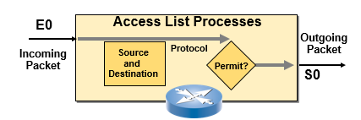
What are access lists?
  Standard ACL
    Use source address as filtering standard
    Can generally restrict a kind of protocol
  Extend ACL
    Use source address and destination address to filter packets
    Can restrict a concrete protocol accurately
  Inbound or Outbound

Slide 6
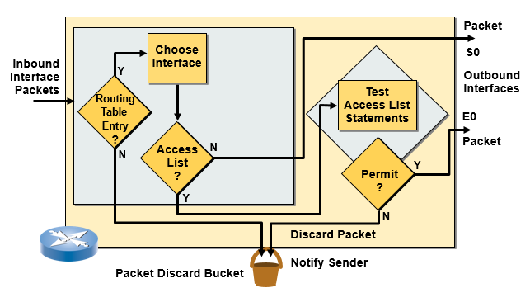
Outbound Access Lists
If no access list statement matches then discard the packet

Slide 7
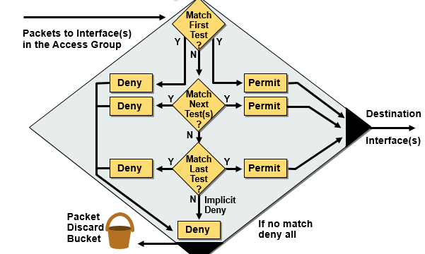
A list of tests: Denay or permit

Slide 8
ACL filter standard
Frame Header
(如HDLC)
Packet Header
(IP Header )
Segment
(TCP Header)
Data
Port number
Protocol
Source Address
Dest Address
Use ACL to check
data
Deny
Permit

Slide 9
ACL cont..
Top to bottom ordering, first match
Implicit deny rule at the end
Applying ACLs to IP interfaces or services
Creating ACL before using it
Set one ACL for a specific protocol on one interface and one direction at one time

Slide 10
ACL Configuration Steps
1: Set standard judge sentence
(one ACL can be made up of many sentences)
Router(config)#
access-list access-list-number { permit | deny } { test conditions }
2: Apply ACL to interface
Router(config-if)#
ip access-group access-list-number {in | out}
  IP access-list-number range from 1-99 or 100-199

Slide 11
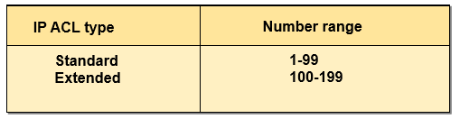
ACL number range
  Standard ACL (1 to 99) control packets on the source IP address
  Extended ACL (100 to 199) judge packet according to the source address, destination address, protocol type, destination port.

Slide 12
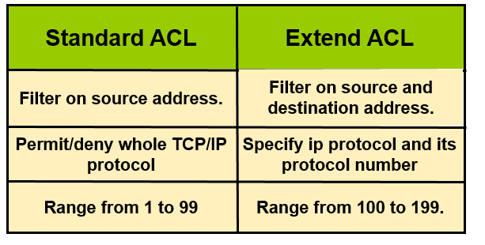
Comparison

Slide 13
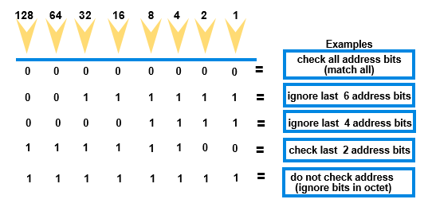
Usage of Wildcard
  0 means must be the same with the address
  1 means can be any

Slide 14
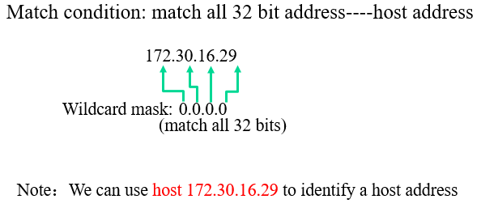
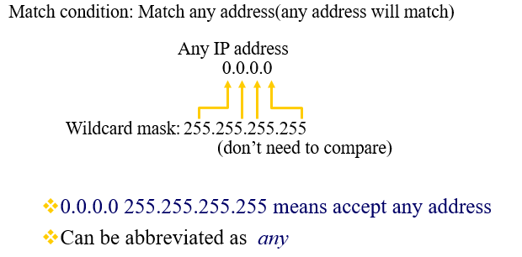
Match specific host
Match Any Address

Slide 15
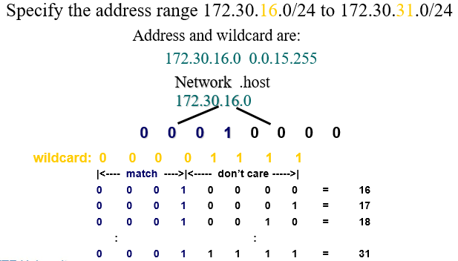
Match Specific Sub Network

Slide 16
Configure Standard ACL
Router(config)#
access-list access-list-number {permit|deny} source [mask]
  IP standard ACL use number 1 to 99
  Default wildcard is 0.0.0.0
  “no access-list access-list-number” delete the entire ACL
router(config-if)#
ip access-group access-list-number { in | out }
  Apply ACL to interface
  Configure the inbound or outbound direction
  “no ip access-group access-list-number” delete ACL on interface

Slide 17
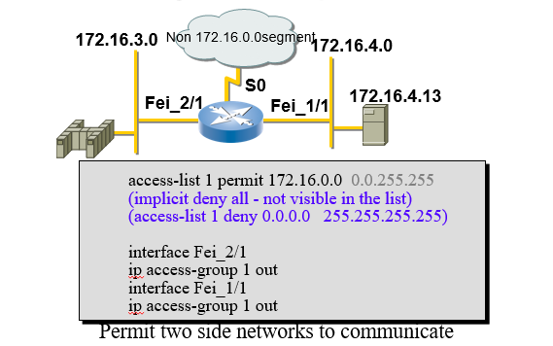
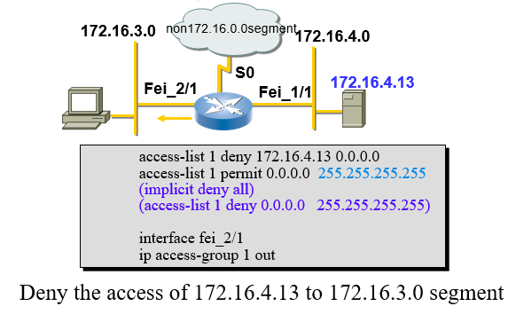
Standard ACL configuration Example1
Standard ACL Configuration Example2

Slide 18
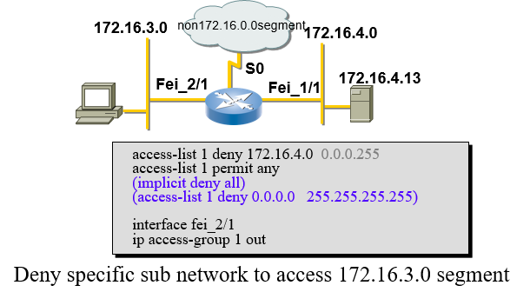
Standard ACL Configuration Example3

Slide 19
Filter telnet access to router
Router(config)#
line telnet access-class access-list-number
Use ACL to restrict access from vty
Control telnet access
access-list 12 permit 192.89.55.0 0.0.0.255
line telnet access-class 12
  Only permit telnet access from 192.89.55.0 segment

Slide 20
Extend ACL Configuration
Router (config)#
access-list access-list-number { permit | deny } protocol source source-wildcard [operator port] destination destination-wildcard [ operator port ] [ established ]
  Configure Extend ACL
Router (config-if)# ip access-group access-list-number { in | out }
  Apply it to interface

Slide 21
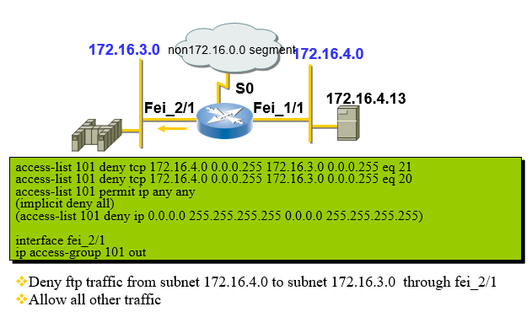
Extend ACL Configuration
Example1

Slide 22
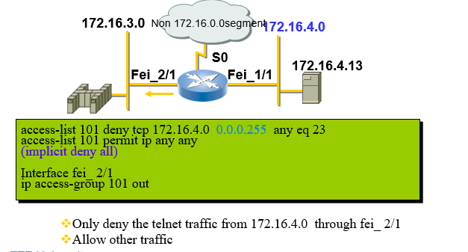
Extend ACL Configuration
Example 2

Slide 23
ACL Configuration Principle
The sequence of ACL statements is very important
  ACL execute from top to down，if one statement match will execute and then jump out of ACL. So it is very important to arrange the sequence of statements in ACL.
From Top to Down Executing Sequence
  Concrete statement should be put in the front
  Standard ACL can order automatically：
    host
    segment
    any
Deny all implicitly
  Unless there are specific permit statement, all the traffic will be denied, so there must be a permit statement.

Slide 24
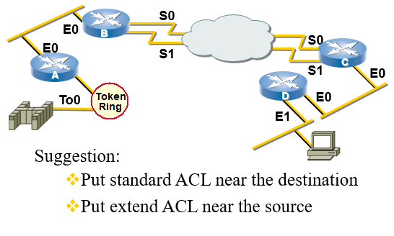
Where to Place ACL?
Show ACL
Router #show ip access-list 1
Standard IP access list 1
permit 10.1.1.0, wildcard bits 0.0.0.255
permit 20.1.1.0, wildcard bits 0.0.0.255
permit 30.1.1.0, wildcard bits 0.0.0.255

Slide 25
Questions for u?
Where to place standard ACL in the network? Where to place extend ACL?
What will be done to the packet if there are no matches in the ACL?
What will you arrange the sequence of the items in ACL?
What will happen if a data packet pass an interface that no ACL is defined?
In the following ACL, there is only one line to filter data packet:
  access-list 100 permit tcp 145.22.3.0 0.0.0.255 any eq telnet
  What does the implicit ‘DENY ALL’ deny?

Slide 26
Rip routing loop prevention mechanisms
Split horizon
Poison reverse
Hold own timer

